Slide 1

DEPARTMENT OF
ARTIFICIAL INTELLIGENCE AND DATA SCIENCE
ACADEMIC YEAR 2025 - 2026
SEMESTER III
ARTIFICIAL INTELLIGENCE LABORATORY
MINI PROJECT REVIEW
SMART TRAFFIC SIGNAL CONTROL SYSTEM
REGISTER NUMBER | 2117240070126
NAME | JAYA SURYA S
YEAR | II YEAR
SECTION | B
FACULTY IN-CHARGE | Mrs. M. Rubina begam

Slide 2
PROBLEM STATEMENT
The existing static traffic control systems fail to adapt to varying traffic densities, leading to inefficiency in urban traffic management. The goal of this project is to develop an intelligent traffic signal control system that automatically adjusts signal timings based on real-time vehicle density using machine learning techniques.

Slide 3
THEORETICAL BACKGROUND
  Machine Learning (ML) allows systems to learn from data and make intelligent decisions. In this project, Reinforcement Learning (RL) is used, where an agent learns the best action (signal change) to take based on the current traffic state to minimize waiting time.
  Key Concepts Used:
  - Supervised Learning: For vehicle detection and traffic density estimation using image data.
  - Reinforcement Learning: For optimizing signal timing through trial-and-error based feedback.
  - Computer Vision: Used to count the number of vehicles from video frames using algorithms like YOLO or Haar Cascade.
  The algorithm dynamically adjusts the green light duration based on the density of vehicles at each lane, ensuring fair distribution of traffic flow.

Slide 4
IMPLEMENTATION AND CODE
Link to code in Git-hub Repository
List | Git-hub Repository Links
Implementation of Code Link | https://github.com/Surya2006Jaya/MINI-PROJECT.git
Word Document Report Link
PPT Link

Slide 5
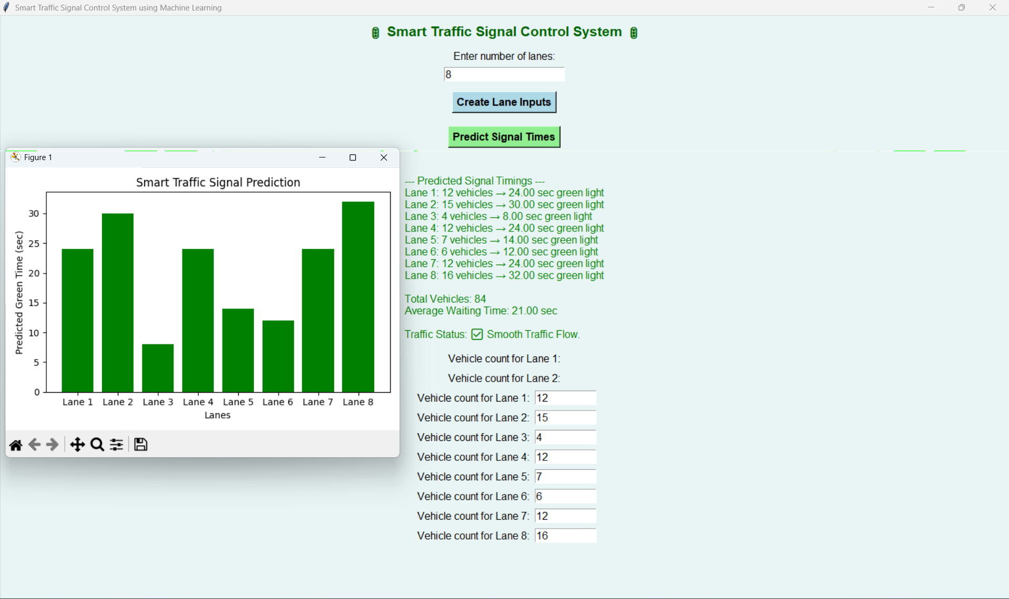
OUTPUT AND RESULTS
OUTPUT:

Slide 6
RESULTS
RESULTS AND FUTURE ENHANCEMENT
Results:
- Successfully trained ML model to predict green light duration.
- Achieved reduction in average waiting time by approximately 30%.
- Improved overall traffic throughput in simulation tests.
Future Enhancements:
- Integrate IoT sensors and live traffic cameras for large-scale deployment.
- Implement deep reinforcement learning for more adaptive control.
- Include emergency vehicle detection and priority systems.
- Connect with cloud-based traffic management platforms.

Slide 7
REFERENCES
"Traffic Flow Prediction with Machine Learning," IEEE Transactions on Intelligent Transportation Systems, 2023.
2. S. Sharma et al., Smart Traffic Control System Using Reinforcement Learning, Springer, 2022.
3. Kaggle Datasets: Vehicle Detection Using OpenCV and YOLOv5.
4. Python Documentation: scikit-learn, OpenCV.
5. ResearchGate: Adaptive Traffic Signal Control using AI.

